Slide 1
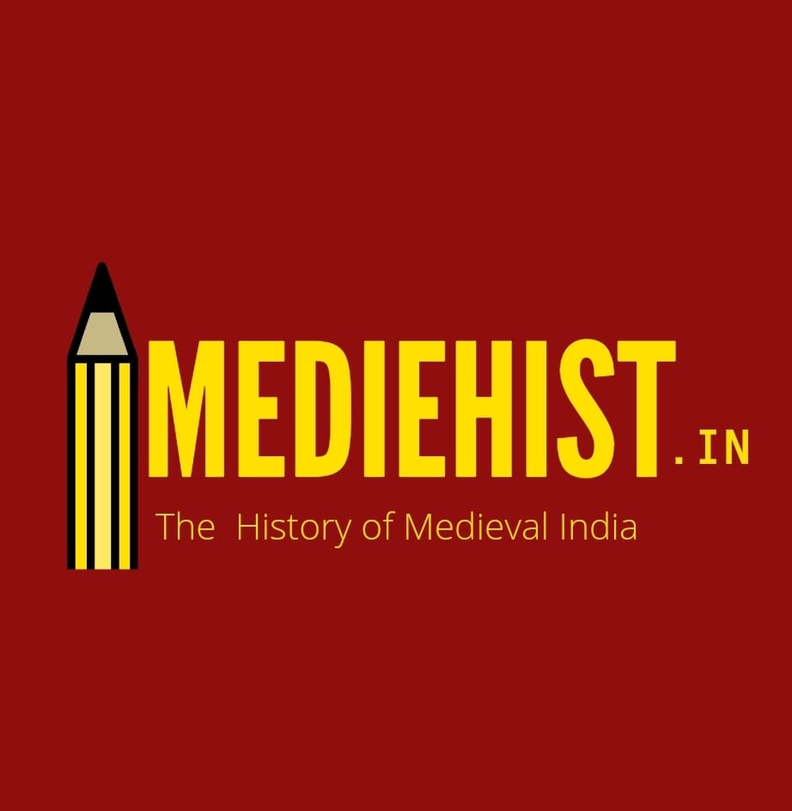
Social Media Marketing
Facebook Campaign Ads
By: Shuvojit Kar
2020-21

Slide 2
Campaign Problem Statement
Blog topic and link: www.mediehist.in
Budget provided: 1000
Objective: My Target Group is Demographic { Education and Survey of Field study in Historical Places} Medieval Indian History Interest { Additional Interest} blog, middle Ages, and Indian Medieval History Lead Traffic to our website and increase the awareness for the same.
TG: Male / Female, Across India, Age Group Between 23 – 34 Audience who are interested in this Field Medieval Indian History mainly and similar.

Slide 3
Explain the targeting parameters
Targeting parameters:
Age Range: 23 to 34 Years - As per the audience insights people in this age group are more enthusiastic about Education and medieval Indian history understand much better, so chose the parameter.
Location: India – Delhi, Mumbai, Pune, (Maharashtra) Kolkata,(West Bengal) Chennai,(Tamil Nadu ) Hyderabad,(Telangana) Kerala, and Bangalore (Karnataka).
Interests: My Blog, Middle Ages, Indian History, Field Survey This is my interest and watching my ads and reading my blog.
Any other relevant targeting parameters: Behavior, Facebook Access (mobile) all mobile device , Facebook access (mobile) smartphone and tablets Facebook access (mobile) Android Device – As per Audience insights majority of people follow historical details and education purposes on their Android device, smartphones and tablets so, choose these behavioral parameters.

Slide 4
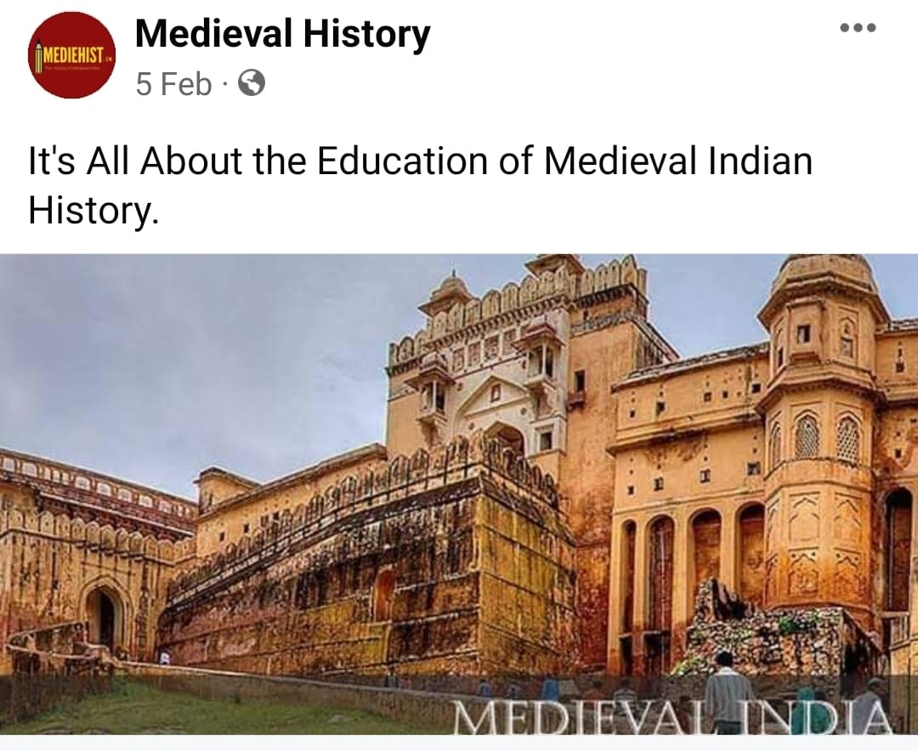
Campaign summary screenshot- 2
Headline, text, and CTA.}
Primary Text: IT’S ALL ABOUT THE EDUCATION OF MEDIEVAL INDIAN HISTORY
Headline: Relive the amazing medieval Indian stories with mediehist. in
CTA : Learn More
Landing Page: https://mediehist.in

Slide 5
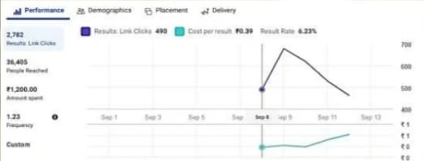
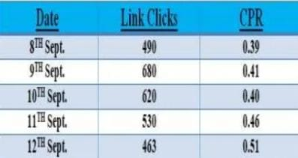
Campaign result screenshot- Performance

Slide 6
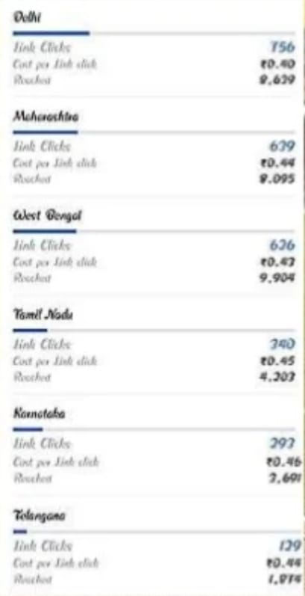
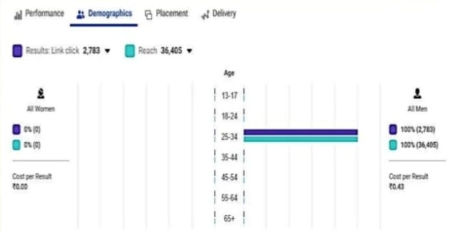
Campaign result screenshot- Demographics

Slide 8
Summary
As our primary objective was to increase the traffic, so the KPLs and would we consider are :
Primary KPLs: CPC and CTR
Secondary KPIs: Engagement Rate, Reach, Impressions
Average CTR in Industry is 1.91%, CTR achieved is 6.59%
CPC – 0.41
Frequency- 1.23
Impressions – 44,665
Reach – 36,405
I can say that ad campaign was pretty much a successful one because the ad achieved a good CTR was after the campaign compared to the industry average . The ad achieved a good amount of engagement – Ad got 2.9k views, was liked by 100 people and was shared 2 times. Other than this given the duration of the campaign a very good amount of reach and impressions were achieved.

Slide 9
